Slide 1
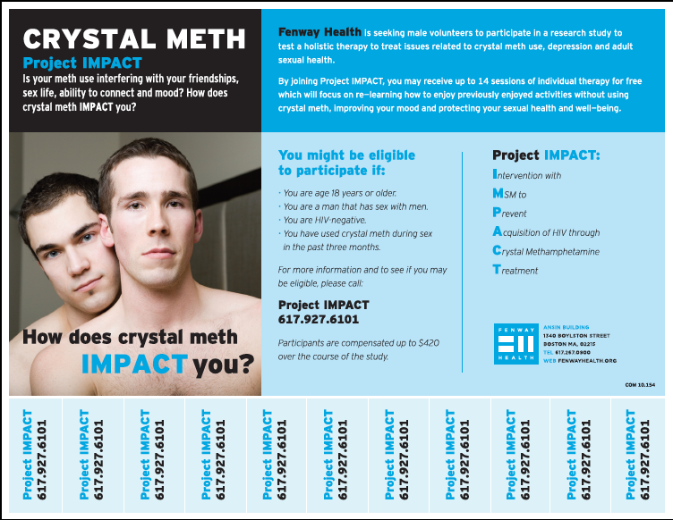
Behavioral Activation Integrated with Sexual Risk Reduction Counseling for High-Risk MSM with Crystal Methamphetamine Dependence: An Initial Randomized Controlled Trial of Project IMPACT Matthew J. Mimiaga, David W. Pantalone, Katie B. Biello, Jaclyn M.W. Hughto, John Frank, Conall O’Cleirigh, Sari L. Reisner, Arjee Restar, Christopher M. Santostefano, Kenneth H. Mayer, Steven A. Safren
BACKGROUND
Men who have sex with men (MSM) continue to be the largest risk group for incident HIV infections in the United States.
Domestically, crystal methamphetamine use is endemic to urban MSM and is highly associated with engaging in condomless anal sex (CAS) and HIV transmission.
Behavioral activation (BA) is an evidence-based approach for depression that involves identifying and participating in pleasurable, goal-directed activities.
We hypothesized that BA will re-engage participants in pleasurable non-drug use activities that will serve as a natural reinforcement for functional behavior, improve depressed mood when not using by experiencing increases in pleasure and mastery, and decrease overall distress so that this group of MSM can benefit better from HIV risk reduction counseling.
METHODS
Study conditions
Recruitment: Between January 2013 and January 2015
Assessments: Baseline, 3-, and 6-months
Outcomes:
(1) Number of distinct CAS acts with men who were HIV infected or whose HIV status they did not know, including in the context of crystal meth use.
(2) The longest period of non-use of crystal meth in the prior 90 days.
Analysis:
Tested intervention effects by specifying a Poisson distribution and log link.
All analyses were conducted in SAS (version 9.4).
 | IMPACT | Number of sessions | Description
 | Baseline | 1 | Orient, establish rapport, gather information on mental health, patterns of substance use, and prior treatment
SOC | Sexual risk reduction (SRR) | 2 | Promote risk reduction, enhance motivation to engage in healthier behaviors, and support strategies to change
 | Cognitive behavior therapy (CBT) for substance abuse | 3 | Identify triggers for stimulant use, strengthen and generalize skills to successfully manage these triggers
 | Behavioral activation (BA) with risk reduction (RR) | 6 | Review instances of substance use or sexual risk, monitor mood in context of pleasurable, non-drug use activities
 | Review and plan for relapse | 1 | Review prior skills discussed, problem-solve to address remaining obstacles and anticipate high-risk situations
 |  | 13
Funded by NIDA
R34DA031028, PI: Mimiaga
K24DA040489, PI: Safren)
Notes:
One potential contributor to the challenge of existing treatments may be a lack of attention to replacement activities or the role of depressed mood.

Slide 2
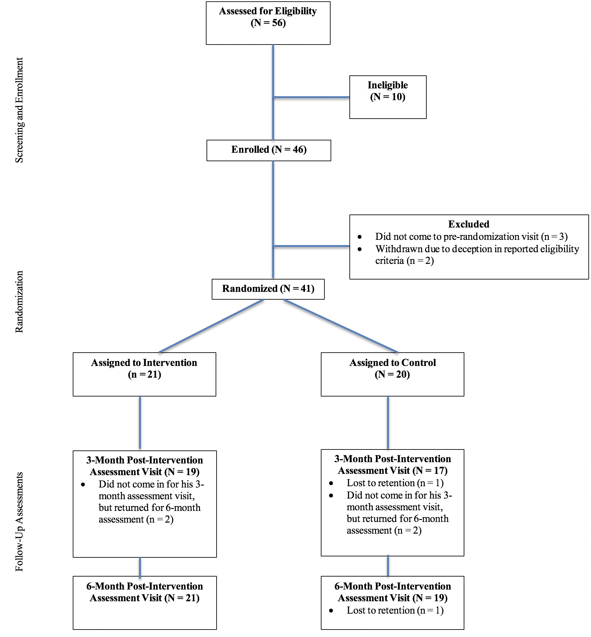
RESULTS
Study and Participant Flow: Screening, Enrollment, Randomization, and Follow-Up Assessment Visits
 | Overall N = 41 | IMPACT N = 21 | Control N = 20 | p-value
 | Mean (SD)
Age in years (range 25-65) | 39.8 (11.6) | 39.7 (13.2) | 39.9 (10.1) | 0.950
CAS acts, serodiscordant partner, past 3 months (range 0-43) | 6.9 (9.7) | 5.0 (7.7) | 9.0 (11.2) | 0.190
CAS acts, serodiscordant partner, high on crystal meth, past 3 months (range 0-43) | 6.2 (9.4) | 4.5 (7.3) | 8.0 (11.0) | 0.246
Longest period did not use crystal meth, past 90 days (range 0-80) | 23.4 (18.8) | 24.7 (20.0) | 22.1 (17.8) | 0.661
 | N (%)
Race/ethnicity |  |  |  | 0.224
White race | 32 (78.0) | 18 (85.7) | 14 (70.0)
Racial/ethnic minority | 9 (22.0) | 3 (14.3) | 6 (30.0)
Education |  |  |  | 0.443
Less than high school; diploma/GED; some college | 18 (43.9) | 8 (38.1) | 10 (50.0)
College degree or more | 23 (56.1) | 13 (61.9) | 10 (50.0)
Employment |  |  |  | 0.890
Employed full or part time | 18 (43.9) | 9 (42.9) | 9 (45.0)
Unemployed/disabled | 23 (56.1) | 12 (57.1) | 11 (55.0)
Annual income |  |  |  | 0.837
Less than $12,000 | 14 (35.0) | 8 (38.1) | 6 (31.6)
$12,000 to $59,999 | 17 (42.5) | 8 (38.1) | 9 (47.4)
$60,000 or more | 9 (22.5) | 5 (23.8) | 4 (21.0)
Sexual orientation |  |  |  | 0.431
Gay | 29 (70.7) | 16 (76.2) | 13 (65.0)
Not gay | 12 (29.3) | 5 (23.8) | 7 (35.0)
Any prior crystal meth treatment |  |  |  | 0.133
Yes | 15 (36.6) | 10 (47.6) | 5 (25.0)
No | 26 (63.4) | 11 (52.4) | 15 (75.0)
Route of crystal meth administration
Smoked | 38 (92.7) | 19 (90.5) | 19 (95.0) | 0.578
Snorted | 9 (21.9) | 5 (23.8) | 4 (20.0) | 0.768
IDU (‘‘slam’’) | 23 (56.1) | 13 (61.9) | 10 (50.0) | 0.443
Rectally inserted (‘‘booty bump’’) | 13 (31.7) | 6 (28.6) | 7 (35.0) | 0.658
Trade sex for crystal meth, past 3 mo | 20 (48.8) | 10 (47.6) | 10 (50.0) | 0.879
Socio-demographic Variables
Sample: 46 HIV uninfected MSM at sexual risk of acquiring HIV who met DSM-IV criteria for crystal methamphetamine dependence.
Randomized: 41 MSM: 21 assigned to the IMPACT intervention and 20 assigned to a standard of care (SOC) control

Slide 3
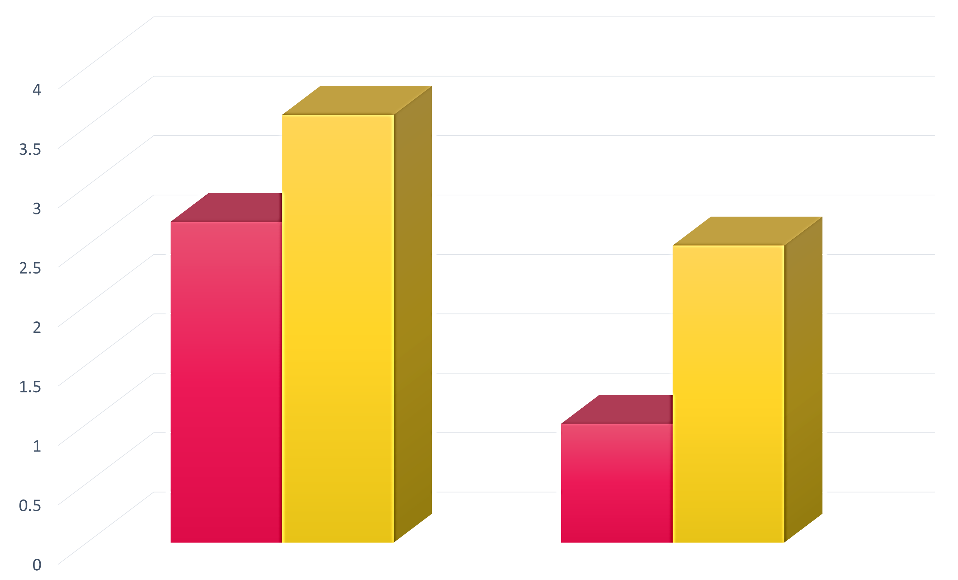
RESULTS
Number of times CAS with partner who was HIV serodiscordant or status unknown
Retention of Study Participants for Follow-Up Assessments (N = 41)
and Number of Completed Intervention Sessions (n = 21)
Mean (SE)
SOC
4.5 (0.5)
 | Completed Assessments*
Assessment Period (N = 41) | Total | Intervention | Control
Baseline | 41 | 21 | 20
3-month assessment | 36 | 19 | 17
6-month assessment | 40 | 21 | 19
Intervention Sessions (n = 21) | Intervention Attendance Total Number Completed**
13 (all sessions) | 16
12 | 0
11 | 2
10
9 | 1
8 | 0
7 | 2
IMPACT
3.2 (0.4)
SOC
2.8 (0.4)
IMPACT
1.1 (0.2)
3 month assessment 6 month assessment
p-value = 0.035 p-value <0.0001
Number of times CAS with partner who was HIV serodiscordant or status unknown while using meth
Mean (SE)
SOC
3.6 (0.5)
IMPACT
2.7 (0.4)
SOC
2.5 (0.4)
*Participant retention at the 6-month follow-up assessment visit was 98%
**Overall completion of intervention sessions was 93%
IMPACT
1.0 (0.2)
Longest period of no meth use, past 90 days
3 month assessment 6 month assessment
p-value = 0.104 p-value <0.0001
IMPACT
DISCUSSION
Mean (SE)
50.1 (1.5)
39.0 (1.4)
40.6 (1.5)
38.5 (1.5)
Findings are encouraging and provide evidence of feasibility (98% retention) and acceptability (93% of counseling sessions attended and all participants rated the intervention as “acceptable” or “very acceptable”).
Initial efficacy for reducing sexual risk for HIV and crystal methamphetamine use among high-risk MSM.
BA techniques can be easily taught to lay-level counselors; this project has value as an easily disseminable, potentially cost-saving approach for use in a wide range of settings.
Future testing in a fully-powered efficacy trial is warranted and currently underway.
SOC
3 month assessment 6 month assessment
p-value = 0.315 p-value <0.0001
IMPACT
3.2 (0.4)

